Slide 1
Recommendation Engine
Intelligence Recommender System

Slide 2

Need of Recommendation Engine
Software that analyzes available data to make suggestions for something that a website user might be interested in (book/video/job/music) among other possibilities.
Speed, ease and relevance are crucial traits that the modern consumer demands.
70% of internet users prefer content that is personalized.
Nearly half of shoppers spend more with a personalized ecommerce experience.

Slide 3
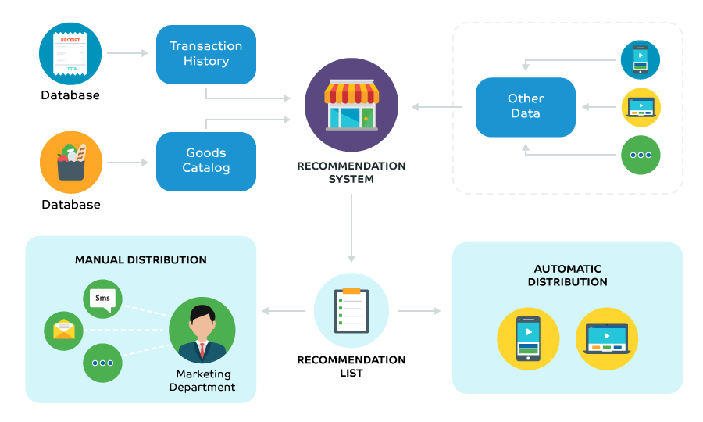
Manual vs Automatic - which one do you like?

Slide 4





Advantages of Recommendation Engine
Notes:
Increase revenues :
One of the most impressive advantages of using search engines is boosting sales for online merchants. With different recommendation engines such as recommended for you, who bought this item also bought, related products, best sellers, and so on, online stores can offer web browsers more choices when they are shopping. Consequently, these methods pay the way to the increase in numbers of items as well as the average value per order. One noticeable example of successful online enterprises when applying product recommendation engines is Amazon. Statistics in 2015 have showed that 35% of Amazon total revenues come from the positive effects of recommendation engines that this giant online merchant used.
2. Create customer satisfaction :
Product recommendation engines perform a really good job in creating a sense of satisfaction among consumers during and even after their searching session. When they enter keywords to look for their desire products, the algorithms will analyze based on several criteria such as keywords, previous purchase,… to figure out customer tastes and preferences. Therefore, visitors can receive appropriate suggestion when they are shopping. Even when they finish purchasing a product, shop admins can also send recommendations to shopping doers via their emails or their next shopping sessions. The proper suggestions at the right time and right place make web browsers easier to find out what they want. This is the way product recommendation engines generate customer retention for all their visitors.
3. Personalize individual interest :
Product recommendation engines provide suggestions not only based on customer tastes and references but also the opinions from other people. It means that a user can take other products purchased by other people into their consideration. Besides, their own opinions about one product via rating or commenting will be recorded to set up their own storage of data. As a result, buyers will receive suggestions individually that make them feel they are given special care and attention.
4: Provide Reports :
This function is integral to a personalization system. In other words, it is the determining factor that directly affects the decision of consumers. By offering them the accurate and the most up-to-date report, the system forces them to make solid decisions about their purchases. In other words, consumers can easily manage their orders thanks to report system.

Slide 5
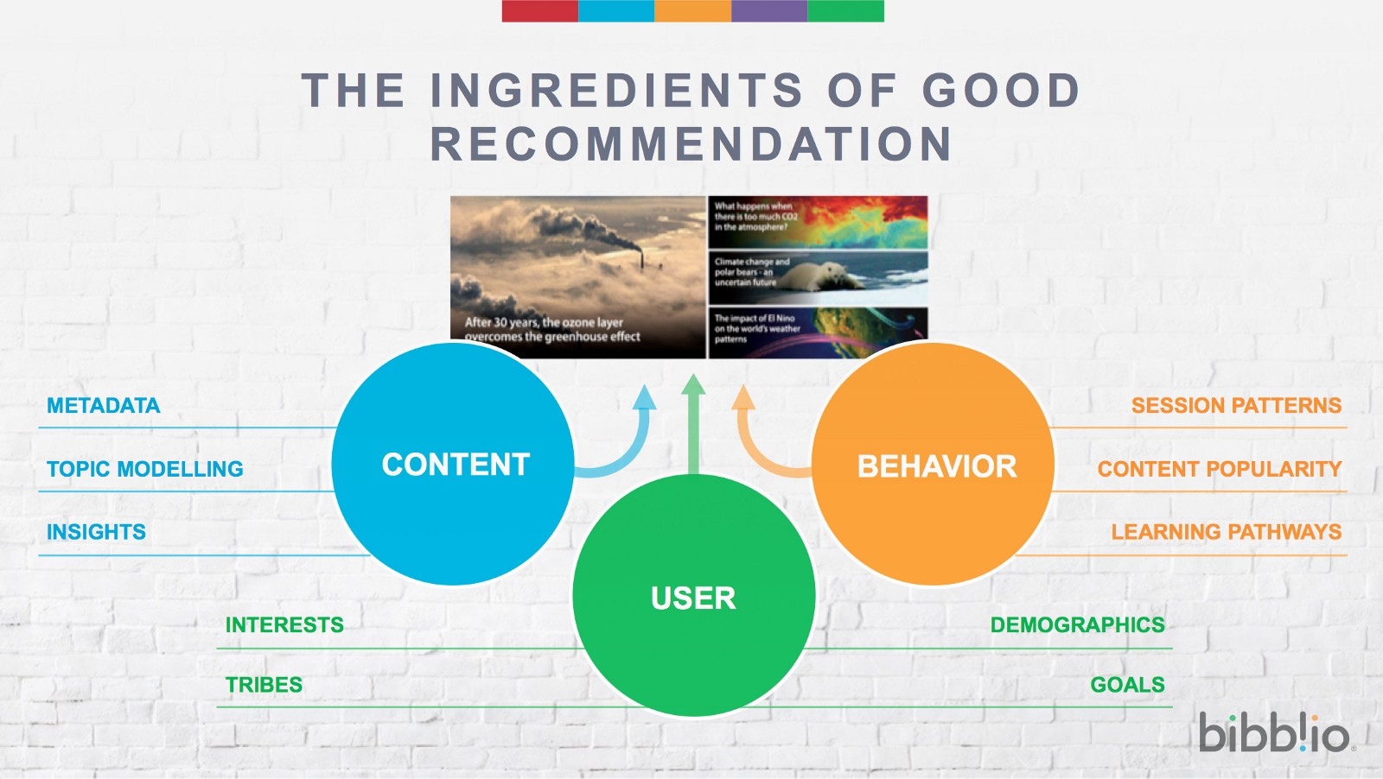
Ingredients

Slide 6
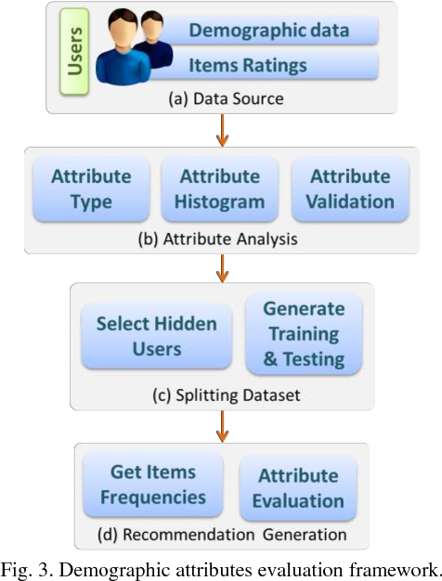
Demographic Recommendation

Slide 7
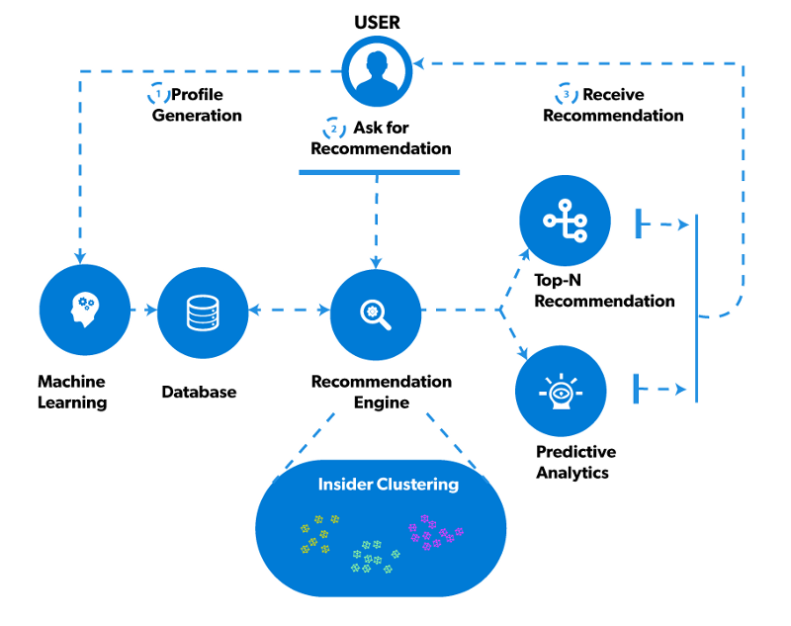
How does a Recommendation Process Work?

Slide 8
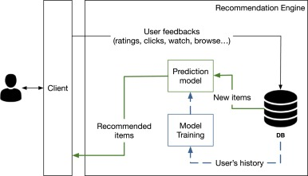
How does a Recommendation Engine Work?

Slide 9

Do you like to build a Intelligence Recommender System?

Slide 10

Thank You !!

